Slide 1
Work on Afera Test Manual –
Status May 2022
Target
Findings
Changes
Further work
For WG TM Meeting 2022-05-25, K. Seitz

Slide 2
Work on Afera Test Manual –
Target
Online-publishable version in 2022
Final draft for TC Meeting Sep.
Definition „Publishable“
  Benchmarking of Afera TMs to what is being published and can be purchased
  Relevant benchmarks: see cross-reference table in manual
For WG TM Meeting 2022-05-25, K. Seitz

Slide 3
Standards equivalent to Afera standards, latest versions - GTFs
Afera GTF | PSTC | latest version | EN | latest version | ISO | latest version
5001 6004 | 101 | 2013 | 1939 | Not found in Beuth | 29862 | 2018-05
5004 6005 | 131 | 2007 | 14410 | Not found in Beuth | 29864 | 2018-05
5012 6006 | 107 | 2007 |  |  | 29863 | 2018-05
5013 6001 | (17) | (2012)
5006 6002 | 133 | 2007 | 1942 | 2008
5014 6007 | (16) | (2013)
GTF 6003 | (71) | (2013)

Slide 4
Standards equivalent to Afera standards, latest versions – no GTFs
Afera | PSTC | latest version | EN | latest version | ISO | latest version
4003 |  |  | 12024 | 1996
4007 |  |  | 12025 | 1996
4007 supplement |  |  | 12025 Annex | 1996
4008 |  |  | 12026 | 1996
4009 |  |  | 12027 | 1996
4010
4011

Slide 5
Standards equivalent to Afera standards, latest versions – no GTFs
Afera | PSTC | latest version | EN | latest version | ISO | latest version
4013 |  |  | 1944 | 1996
4014 |  |  | 12028 | 1996
4015 |  |  | 1945 | 1996
4019 |  |  | 12032 | 1996
4021 |  |  | 12034 | 1996
4022 |  |  | 12035 | 1996
4023 |  |  | 12036 | 1996

Slide 6
Standards equivalent to Afera standards, latest versions – no GTFs
Afera | PSTC |  | EN |  | ISO
4026
4027
4028
4028 Supplement A

Slide 7
Work on Afera Test Manual –
Target
Conclusions for benchmarks
Relevant for GTFs: PSTC Methods from latest edition of Manual – 2014
Relevant for other Methods: ENs – latest versions from 1996
For some methods, there are no relevant benchmarks
ISOs (three) are the most modern benchmarks – not taken into account due to danger of copyrights infringements and deviations from GTF contents.
Cross-reference table claims equivalence of Afera methods to GTFs and ENs (and ISOs)
  Guideline: stay as close //come as close as possible to GTFs, ENs
For WG TM Meeting 2022-05-25, K. Seitz

Slide 8
Work on Afera Test Manual –
Findings
General Findings for GTFs
Texts are in large parts identical to PSTC GTFs, including oddities in contents and language, e. g. „significant places“, no conditioning time…..
Few critical mistakes, e. g. wrong speed for measurements
General Findings for EN equivalents
Texts are in large parts identical to ENs, some more deviations than for the GTFs, in particular order of text parts
Few critical mistakes, e. g. wrong speeds for measurements
Findings for Afera 5012
Both 5012 and corresponding PSTC 107 have (the same) structural deficiencies, need fundamental revision – circumventing wording of ISO 29863.
For WG TM Meeting 2022-05-25, K. Seitz

Slide 9
Work on Afera Test Manual –
Changes
Changes in GTFs
Corrected critical mistakes, e. g. wrong speeds, as long as they were wrong in Afera, only.
adjusted texts of Afera to PSTC as far as possible, e. g. adopted no of specimen to be tested from PSTC manual, Afera 5001
Deviated from alignment in a very few cases, e. g. removed „significant places“ in Afera 5004
Figures: corrected wrong ordering, designation of figures.
Checked for congruence of pictures and text, changed photo in 5006 (Thickness) due to mismatch with text.
Added few photos for illustration purposes
Not changed: missing conditioning times, peculiar language
For WG TM Meeting 2022-05-25, K. Seitz

Slide 10
Work on Afera Test Manual –
Changes
Changes in EN equivalents and others
Basically the same considerations as for the GTFs, with a bit more „freedom“
Adjusted „scope“, „Summary of Test method“, „Significance and Use“ to ENs in some cases, added reporting clause in some cases.
Changed order of text in some cases, better aligment with ENs and more clarity. e.g. Afera 4008 – unwind at high speed
Corrected critical mistakes, wrong speeds.
Completed and corrected reference documents, changed formalities
Changes to others ( w/o EN equivalents) according to best guess
For WG TM Meeting 2022-05-25, K. Seitz

Slide 11
Work on Afera Test Manual –
Changes
Changes in EN equivalents and others - pictures
Drawings cannot simply be replaced by nice „modern“ photos as the methods describe specific devices (e. g. Elmendorf), and in some instances the drawings are the descriptions, e. g. Afera 4010, 4011.
=> drawings to be „modernized“ but not to be replaced by photos.
For some methodes difficulty to get photos, e. g. Quick Stick
For WG TM Meeting 2022-05-25, K. Seitz

Slide 12
Work on Afera Test Manual – upload of drafts of amended TMs
Drafts of amended TMs – the text parts – are uploaded onto TC website
Technical Committee - Afera
For WG TM Meeting 2022-05-25, K. Seitz

Slide 13
Work on Afera Test Manual – further work
Definition of a new layout
Formatting of unformatted drafts into new layout, find agency
Find appropriate photos, modernize necessary drawings
  Contact PSTC whether we can adopt photos from their manual
  Find agency that can work on drawings
Work on layout, pictures etc. must be iterative process
For WG TM Meeting 2022-05-25, K. Seitz

Slide 14
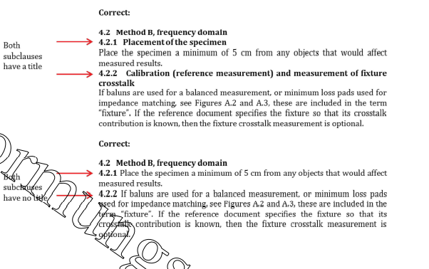
Work on Afera Test Manual – further work
Definition of a new layout, proposal to go in the direction of DIN layout
For WG TM Meeting 2022-05-25, K. Seitz

Slide 15
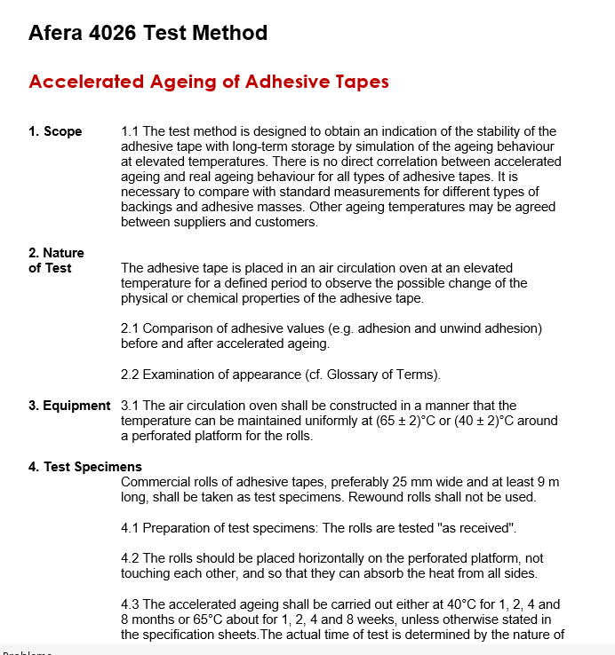
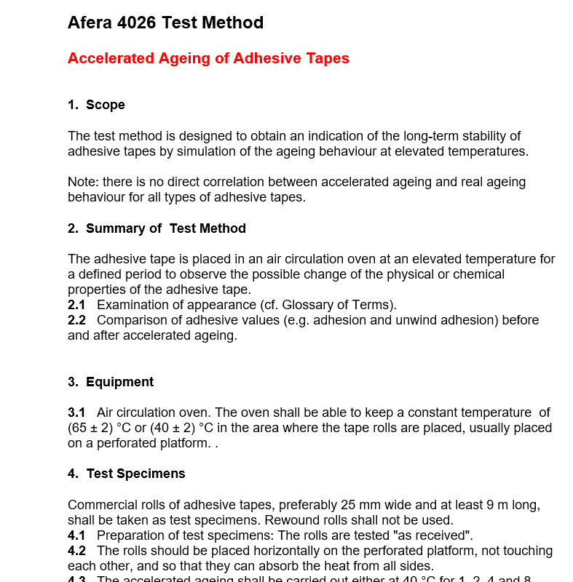
Work on Afera Test Manual – further work
Definition of a new layout, proposal to go in the direction of DIN layout
Current
New
For WG TM Meeting 2022-05-25, K. Seitz

Slide 16
Work on Afera Test Manual – further work
Further informative parts of manual
  4028 + supplement
  Suppliers of Test Equipment
  Proposals for setting up of product specifications
  QS statement
  Glossary of Terms
  Cross Reference Table
Proposal to basically leave as is for the time being, exceptions:
  Check of QS statement in next meeting, amend, if necessary
  Check of supplier list in next meeting, amend, if necessary
For WG TM Meeting 2022-05-25, K. Seitz

